Slide 1

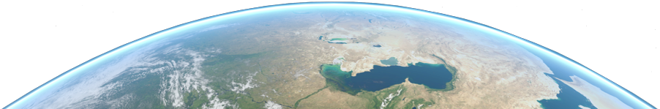


Mission Analysis in Python
A “how-to” crash course
Arnaud MULLER

Slide 2

Table of Contents
TOLOSAT
Introduction
Python Workflow
Tools Used & Recommended
Installation & Testing
Collaborative Coding
Useful Links
05/2021
Mission Analysis in Python
1

Slide 3


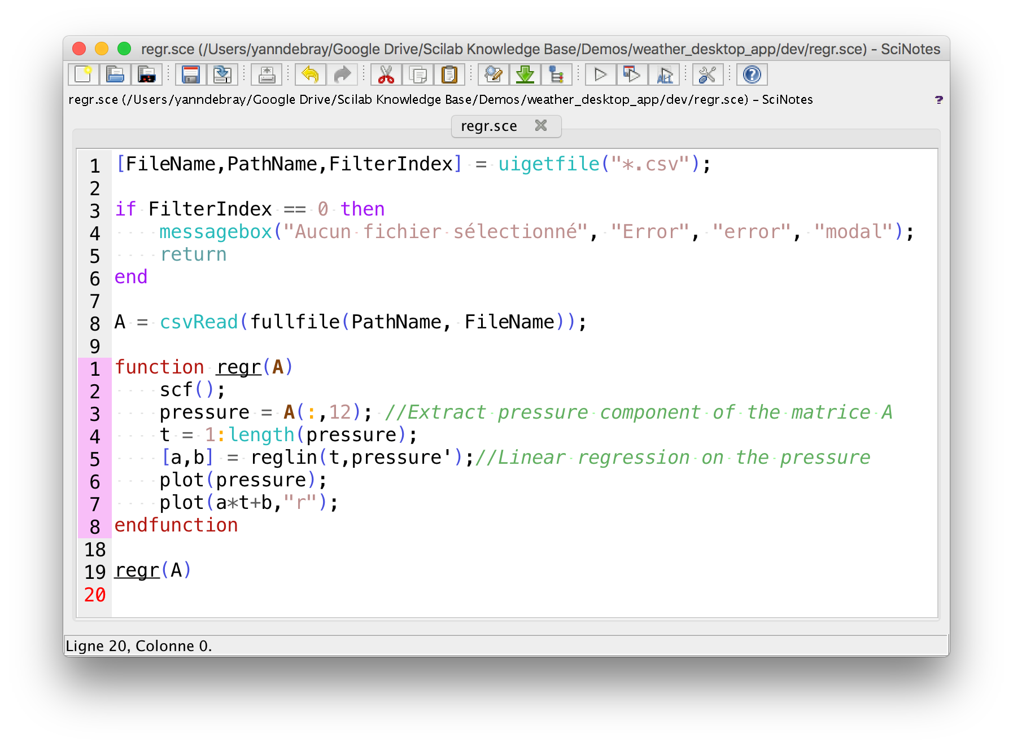
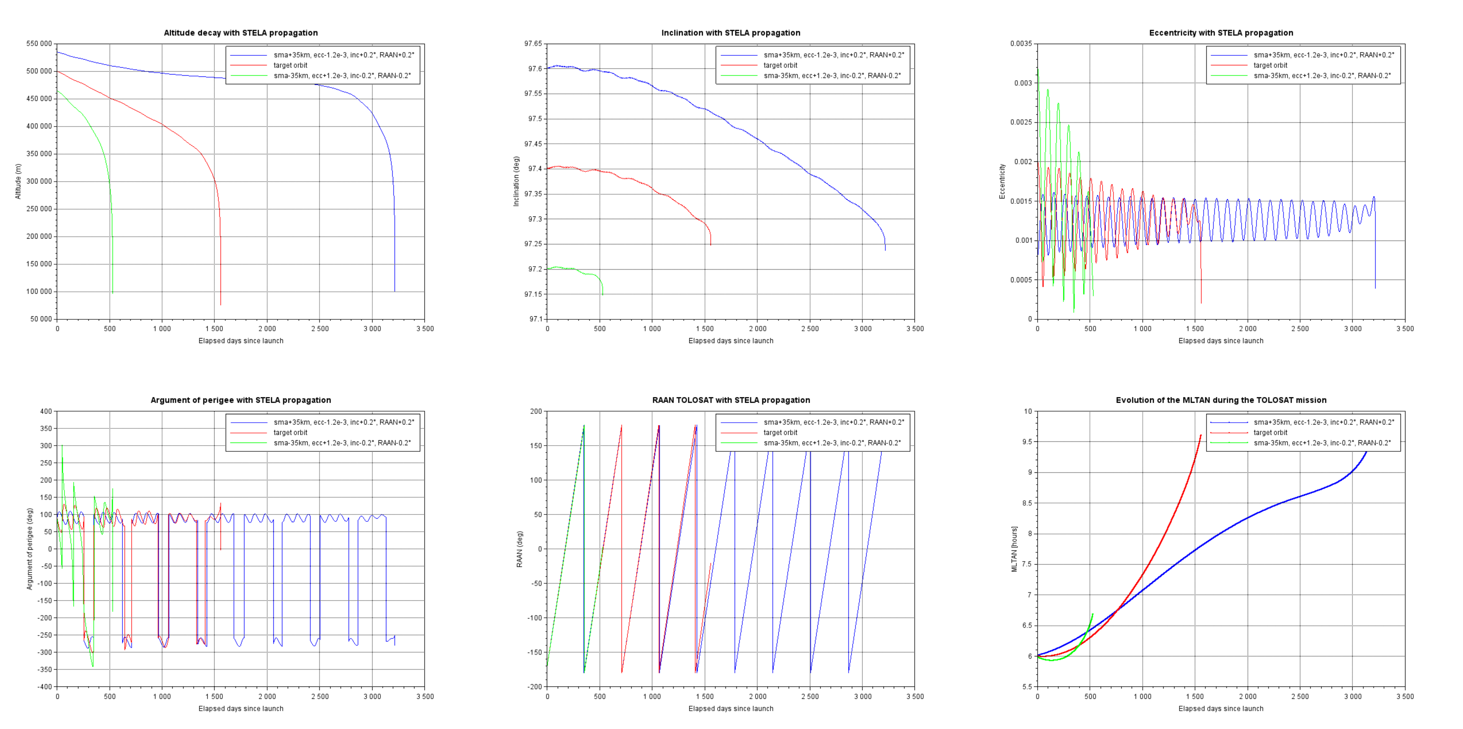
Introduction
TOLOSAT
Some historical context
05/2021
Mission Analysis in Python
2

Slide 4
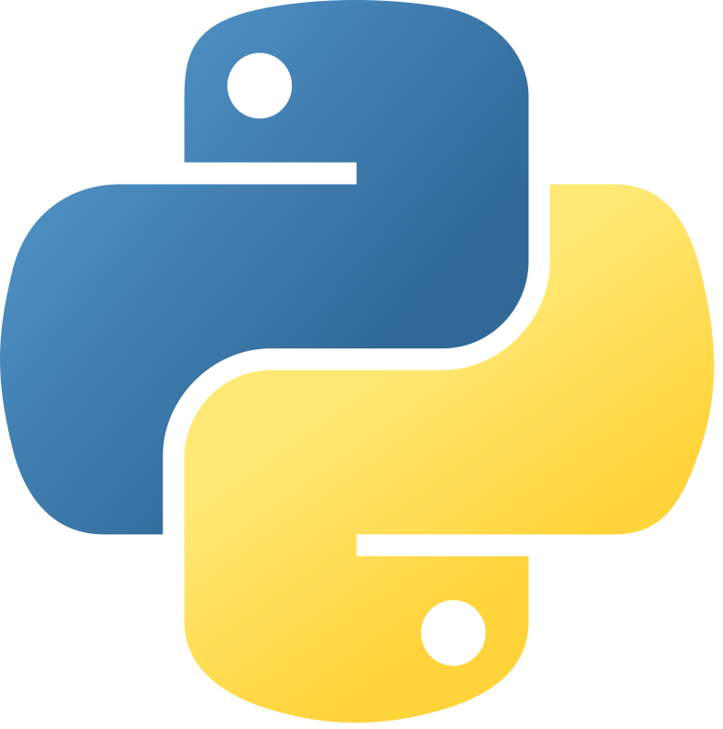
Introduction
TOLOSAT
Why move to Python ?
More modern and flexible language
Easy to learn and use, still allows for high-performance applications through interfaces
Scilab very limiting and outdated (CNES also looking into moving to Python)
Opens access to many free and open-source libraries available
Free choice of IDE and development environment, can wield the power of plugins, etc.
More modular code, easier to collaborate with other subsystems when needed
Mission Analysis in Python
3

Slide 5
Python Workflow
TOLOSAT
Simple Scenario
(Propagation in seconds)
Input data (CSV files)
Specs of ground stations, spacecraft, orbit, etc.
Advanced Scenario
(Longer propagation)
First Python file
Reads input data
Propagation
Exports raw data
Single Python file
Reads input data
Propagation
(Exports raw data)
Computes analyses & plots results
Useful Functions
Standardized plotting & results export tools
Raw data
In CSV, if possible, if not in pickle (PKL) files
Second Python file
Reads raw data
Computes analyses & plots results
Output data
Plots in PNG/PDF, stats in CSV (data in CSV)
Mission Analysis in Python
4

Slide 6
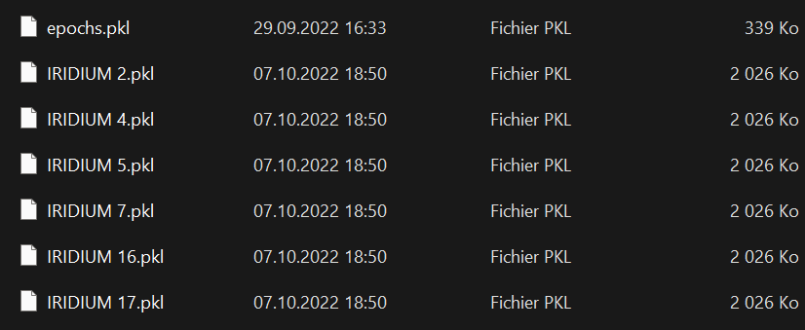
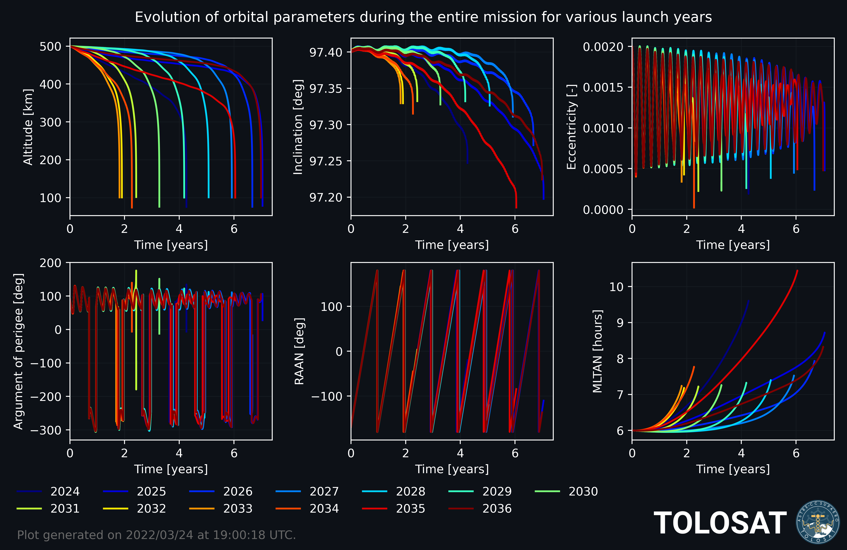
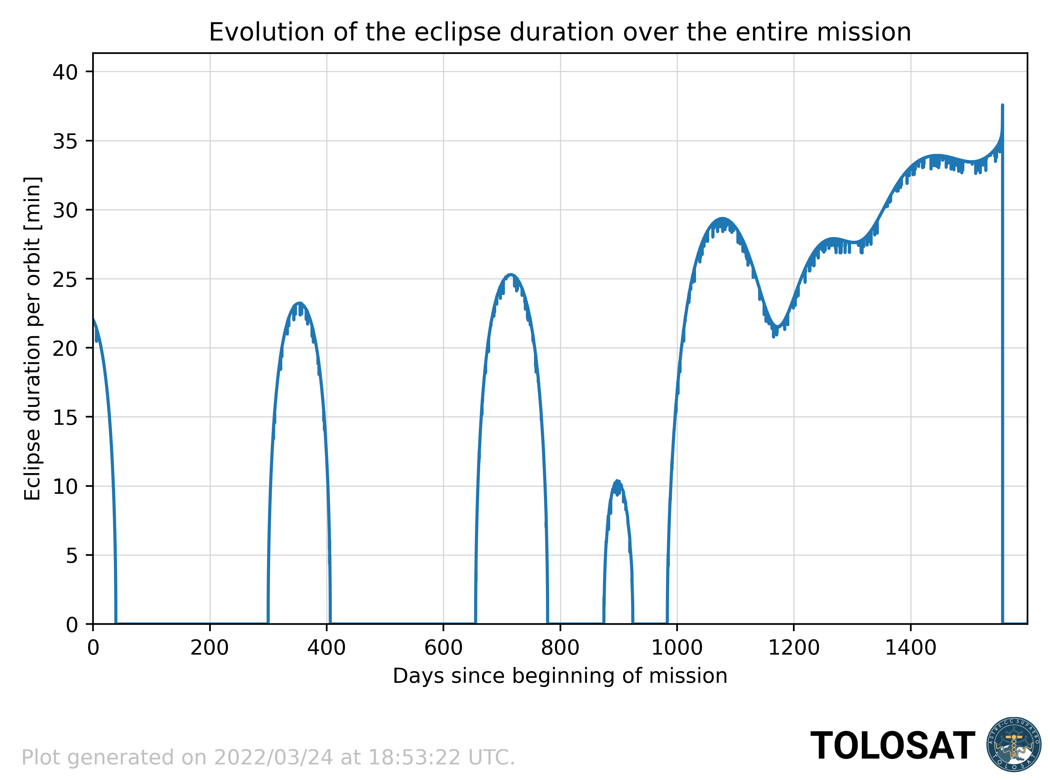
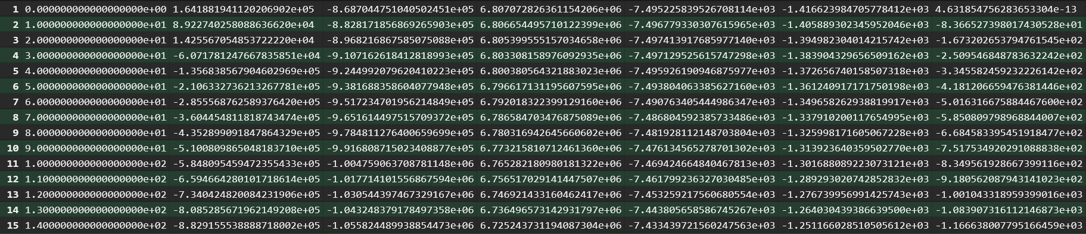
Python Workflow
TOLOSAT
Mission Analysis in Python
5

Slide 7






Tools Used & Recommended
TOLOSAT
Used
Recommended
GitHub Desktop
Mission Analysis in Python
6

Slide 8
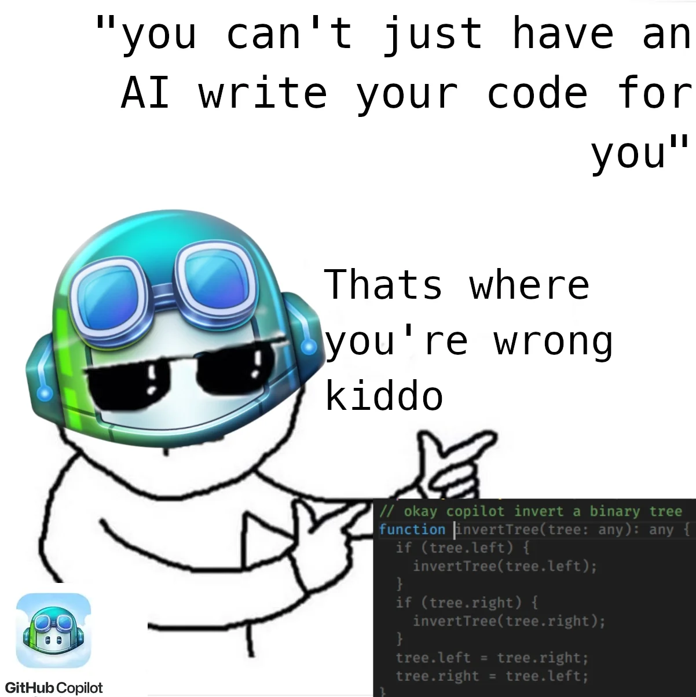
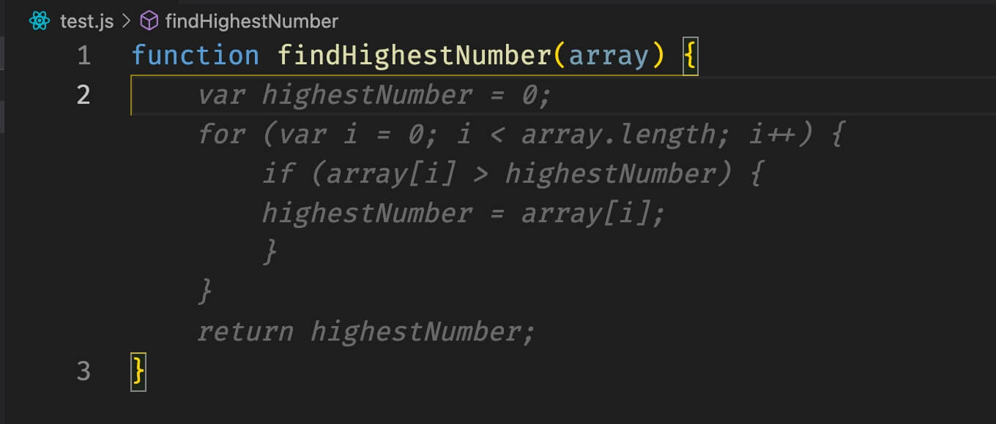
Tools Used & Recommended
TOLOSAT
Important notes
CONDA → You can use ANACONDA, or Miniforge for a lighter install
PyCharm → Free professional licenses are awarded to students (details in the Python setup guide)
GitHub Copilot → Available for free for students through the GitHub Global Campus program
Mission Analysis in Python
7

Slide 9
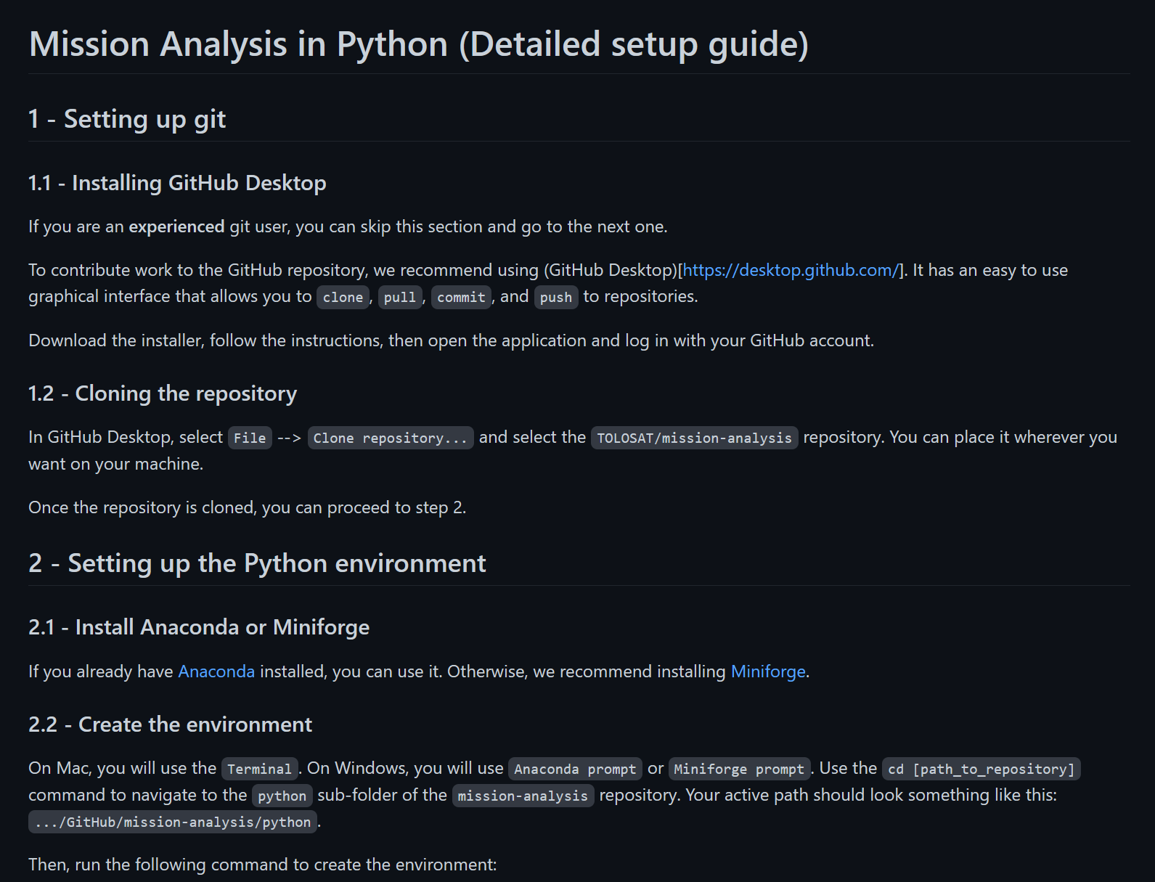
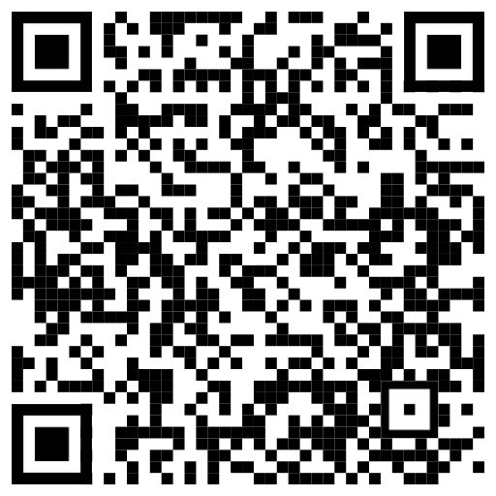
Installation & Testing
TOLOSAT
Follow the setup guide on GitHub → here ←
Mission Analysis in Python
8

Slide 10
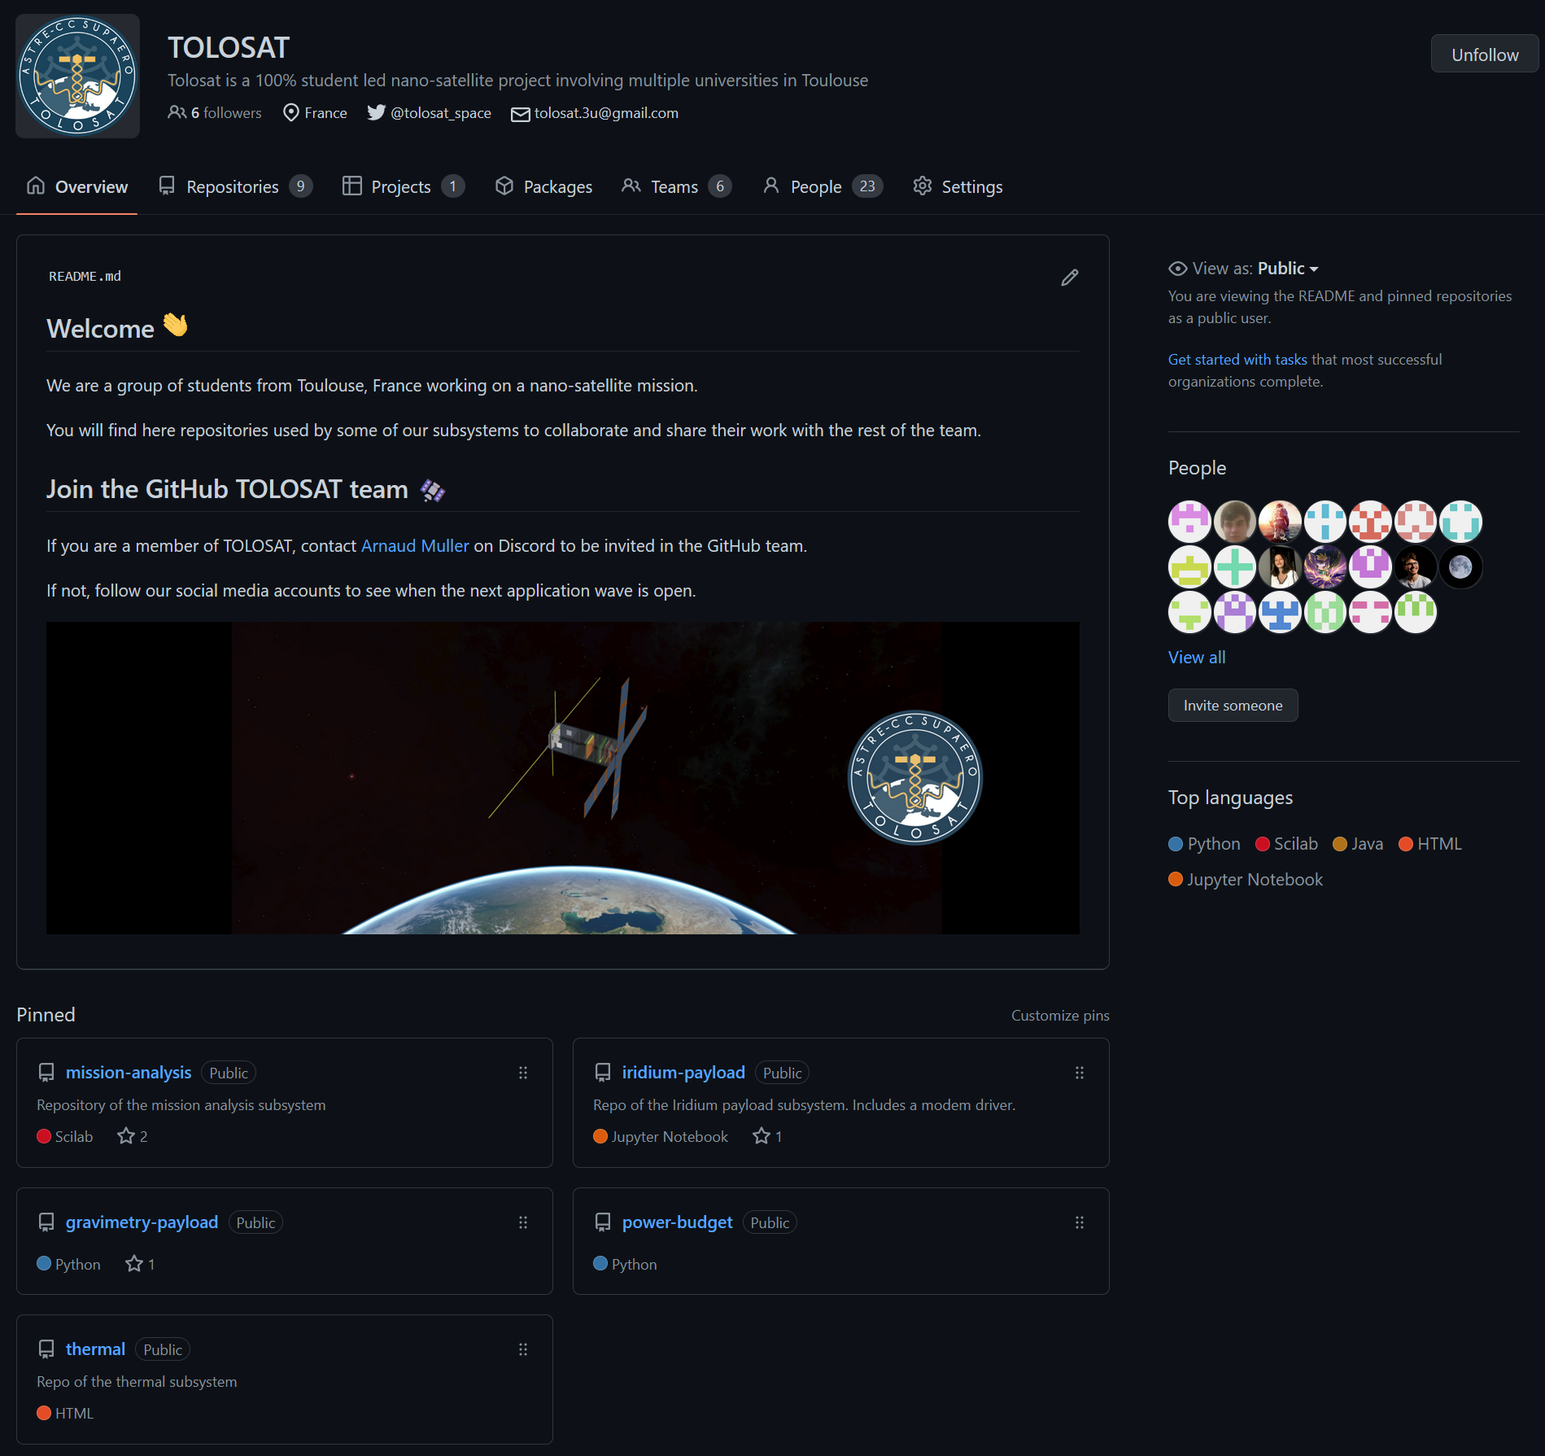
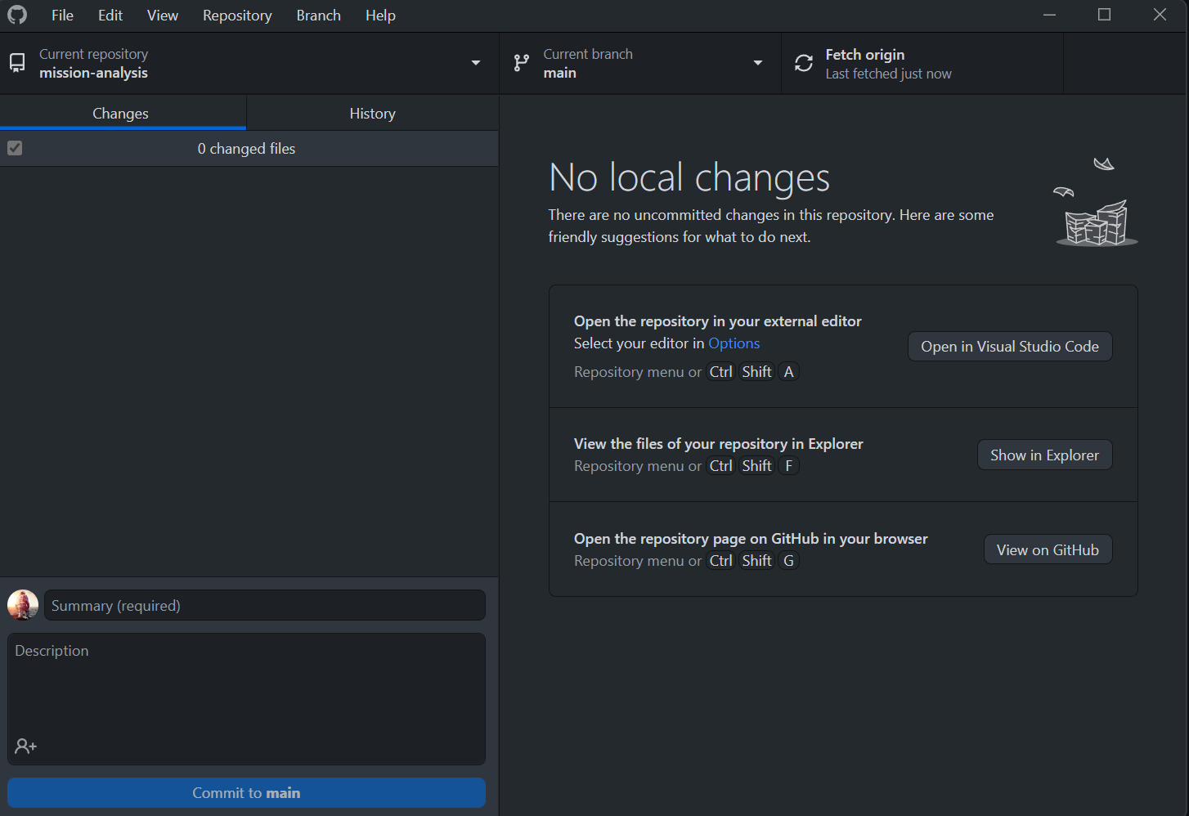
Collaborative Coding
TOLOSAT
To join the TOLOSAT GitHub organization → give your username/email to the person linked on the page
You can use GitHub desktop to push/pull changes between the mission-analysis repository and your machine.
Mission Analysis in Python
9

Slide 11
Useful Links
TOLOSAT
TOLOSAT GitHub : https://github.com/TOLOSAT
Mission Analysis Repository : https://github.com/TOLOSAT/mission-analysis
Detailed setup guide (with more links) : https://github.com/TOLOSAT/mission-analysis/blob/main/python/setup_guide/README.md
GitHub Desktop : https://desktop.github.com/
ANACONDA : https://www.anaconda.com/
Miniforge : https://github.com/conda-forge/miniforge
PyCharm : https://www.jetbrains.com/pycharm/
PyCharm license for students : https://www.jetbrains.com/shop/eform/students
GitHub Global Campus for students : https://education.github.com/globalcampus/student
Tudat documentation : https://docs.tudat.space/en/stable/
Tudatpy API Reference : https://py.api.tudat.space/en/latest/
Mission Analysis in Python
10

Slide 12
The End
… or the beginning !
Arnaud MULLER

